Slide 1
Michael Stifter
WebRTC

Slide 2

Will WebRTC change the world of communications?

Slide 3



Slide 4



Slide 5
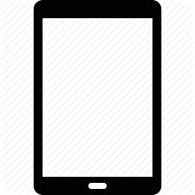

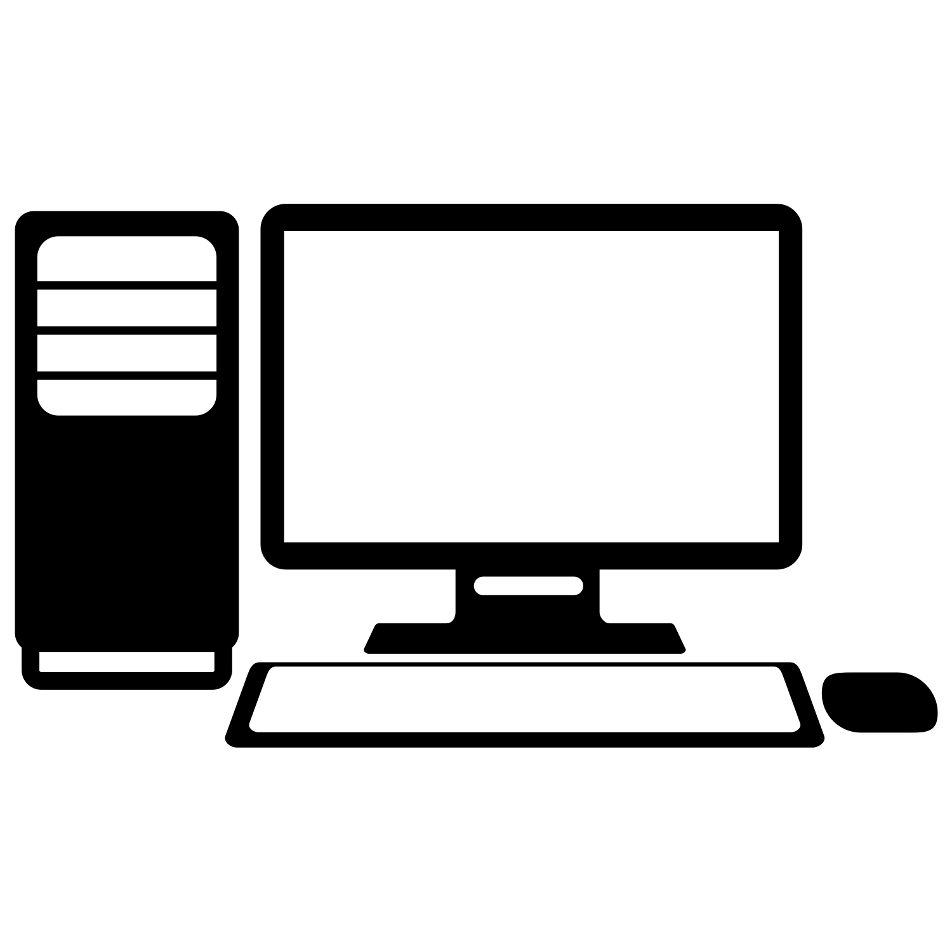
Remote support application
Notes:
Geometric figures for guidance
Text chat messages
Switch between modes (support mode, freeze frame)

Slide 6
Demo time
Notes:
Prototype
Simple application, easily extendable
Open Source
Lightweight management server – everything is self-developed and can be extended
Automatic user discovery (no authentication for now)
Possibility to call one other user (at a time)
Video, audio and text chat
Possibility to share the screen with the other user. Both users can make remarks in form of simple geometric shapes like circles, rectangles or lines that both users can see.

Slide 7
Will WebRTC change the world of communications?

Slide 8
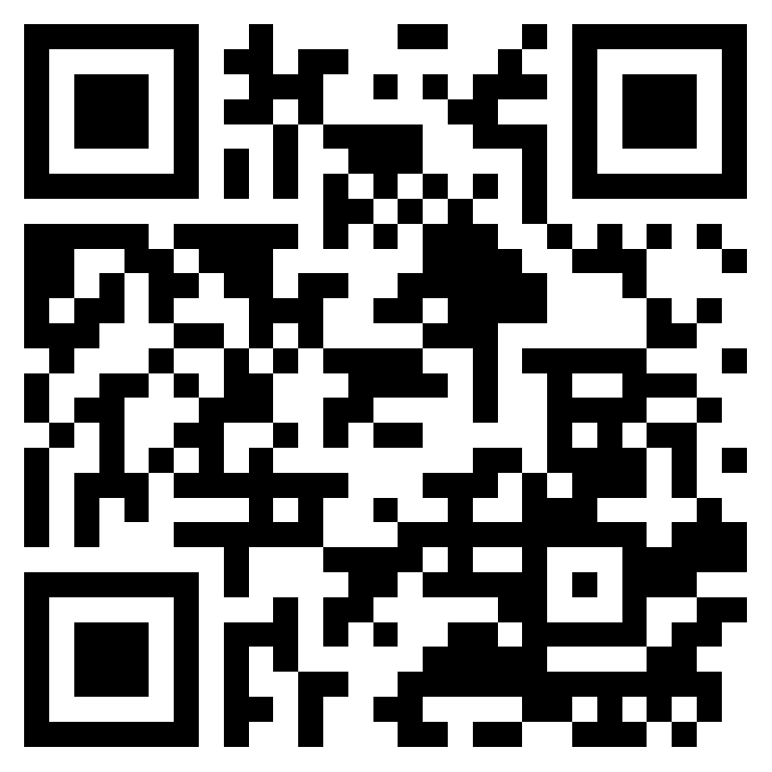
Thanks for your attention!
https://github.com/MICSTI/web-rtc/

